Slide 1


Save Cantonese: A Project to Preserve Cantonese in the West and A Case of Language Advocacy (Personal and Academic Perspectives)
Keith Tse (MCIL CL)
Lancaster University/Ronin Institute/IGDORE
keith.tse@ronininstitute.org
Ronin Lightning Talk (February 2022)
28th February 2022
‘I am a human being!’ (The Elephant Man)

Slide 2
How it all began and how is it going? Brief timeline:
(July 2020) Stanford University’s termination of the contract/full-time position of their Cantonese language instructor (Dr Sik Lee Dennig / 張錫莉 zeong sik lei lousi (literally ‘Teacher Cheung Sik Lei’ (her Chinese name))
(October 2020) Save Cantonese at Stanford: petition to ask Stanford to reverse the decision (4000+ signatures from signatories both within and beyond Stanford), testimonials (former students of Dr Dennig))
(Around the same time) Social Media channels (Facebook, Twitter, Instagram, website (@savecantonese))
(May 2021) Save Cantonese at CCSF (City College San Francisco)
(January 2022) Board Meeting with CCSF; Endowment ($1M) from S. J. Distributors to support Cantonese course at Stanford
Save Cantonese (renamed and rebranded: new logo introduced last month (21st January 2022))): www.twitter.com/savecantonese
https://www.savecantonese.org/
https://tinyurl.com/savecantonese

Slide 3
How it all began and how is it going (for me)?
I joined Save Cantonese at Stanford on 7th January 2021 (date of joining their Slack space) after signing petition on social media (Facebook)
Personal: Hong Kong (where I am from) where Cantonese is the predominant language variety
Academic: Chinese linguistics (formal study of Chinese syntax, esp microvariation between and among Chinese dialects)
Opinion article on Asia Times Online (‘Importance of teaching Cantonese at US universities’) and Cantonese blog 港語學 (gongjyuhok) (‘保衛海外粵語’ ‘Preserve overseas Cantonese’)
https://asiatimes.com/2021/04/importance-of-teaching-cantonese-at-us-universities/
(6th April 2021)
https://gongjyuhok.hk/articles/9864 (24th December 2021)
Asia Times Op-ed’s on Chinese sociolinguistics (www.asiatimes.com/author/keith-tse)
Various blogs and online writings (www.medium.com/@keithtse)
Online writings (blogs/Op-ed’s) for linguistic analysis and language advocacy

Slide 4
Sociolinguistic background: Chinese dialects
Common misconception of Chinese: Mandarin vs Cantonese
‘Do you speak Mandarin or Cantonese?’ (Chinese learner/speaker)
https://asiatimes.com/2018/02/chinese-language-myths-misconceptions/
(my first ever Asia Times Online Op-ed)
A dialect can be regional, social, stylistic (Chambers and Trudgill (1998))
Sociolinguistics/dialectology:
Dialects (方言 fangyan): Topolect (regional variety i.e. language of the place)
Sinosphere (China and beyond) -> hundreds of thousands of (sub)dialects
Classic dialectal classification:
Mandarin (official dialect) (North/北方話)
Cantonese (Yue/粵) (Canton province (South-East China))
Min (閩) (Northern/Southern (閩南/閩北) (Southern China (e.g. Hokkien) + Taiwan)
Hakka (客家) in Southern China
Wu (吳) (Northern (e.g. Shanghainese), Southern (e.g.Wenzhou))
Xiang (湘)
Gan (贛)

Slide 5
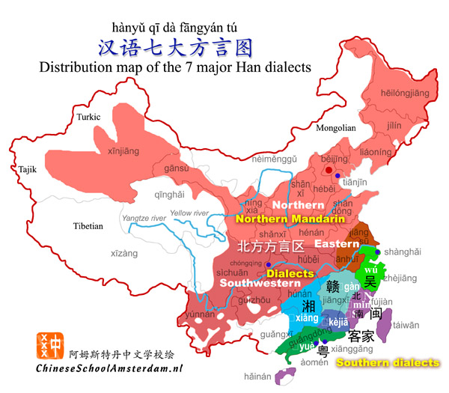
Chinese topolects (方言)
Cantonese (Yue)

Slide 6
What is so special about Cantonese (1 in X number of dialects?)
Cantonese is not just spoken in SE China (Canton province) (map on previous slide)
Cantonese has been spoken by generations of Chinese migrants in the West (especially North America) and beyond
Leland Stanford, founder of Stanford University, hired Cantonese-speaking migrants to build the campus (Save Cantonese)
Cantonese is a heritage language in USA/Canada where there are many diasporae of Chinese communities who only speak Cantonese ->
Chinatowns (唐人街) (唐 tong is a southern Cantonese ethnic term),
expats (華僑) (華人 is an inclusive-term for Chinese ethnicities)
Cantonese is a Sinitic variety with international distribution and heritage status in the West: key for Chinese expats’ language communication and cultural connection
-> Cantonese is not merely a local dialect in southern China but an international heritage language with generations of speakers (cf Min, Hakka, Hokkien, Teochow)

Slide 7
Language advocacy: personal and collective
Endangered Languages (languages with fewer than a thousand speakers)
Endangered Language Fund (cf Endangered Species Act)
http://www.endangeredlanguagefund.org/
(Linguistic Society of America Annual Meeting, 8th January 2022)
Cantonese (far from being endangered) requires preservation from cuts in (higher university/college) education for heritage Chinese speakers
My contributions: Op-ed’s and blogs in online news channels (Asia Times Online, gongjyuhok) and social media (personal blog, Medium) > Language Advocacy
‘Independent scholars, through their academic background and research skills… can play a pivotal role in creating a multilingual society and world. The role of independent scholars is unique in that they bring both scholarly expertise and their independence as thinkers to the conversation. Let’s make sure all of us have the opportunity to add multilingualism to our skills set! (Kathleen Stein-Smith (Ronin blog (23rd February 2022))

